Slide 1
Steve Miller
My Entrepreneurial Journey: The Centrality of Calling

Slide 3
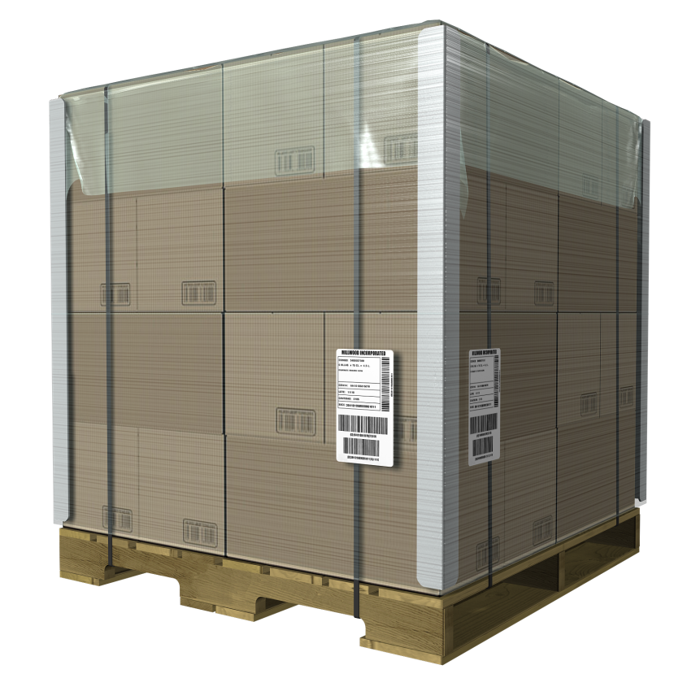
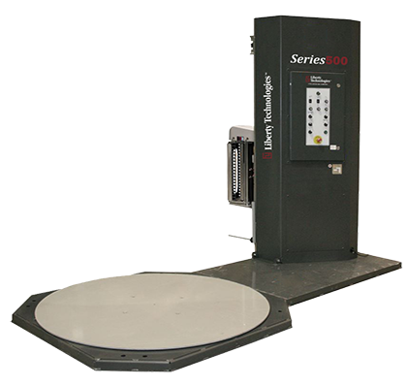
Unit Load - Product Groups
1
Engineered Consumables
2
3
Pallets & Lumber
Engineered
Systems

Slide 4
Our Locations

Slide 5
It’s just a pallet…

Slide 6
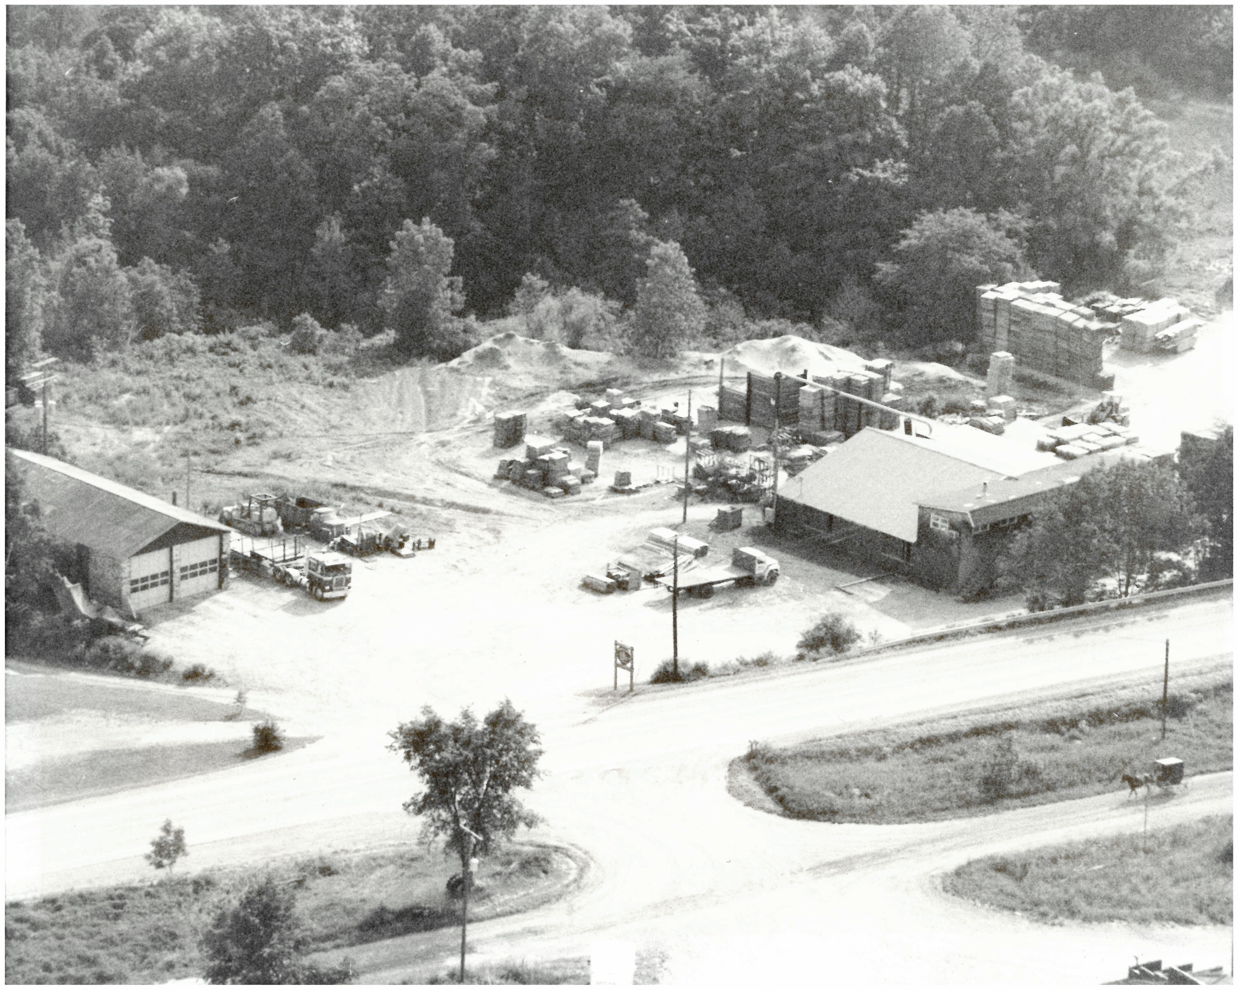

Slide 7
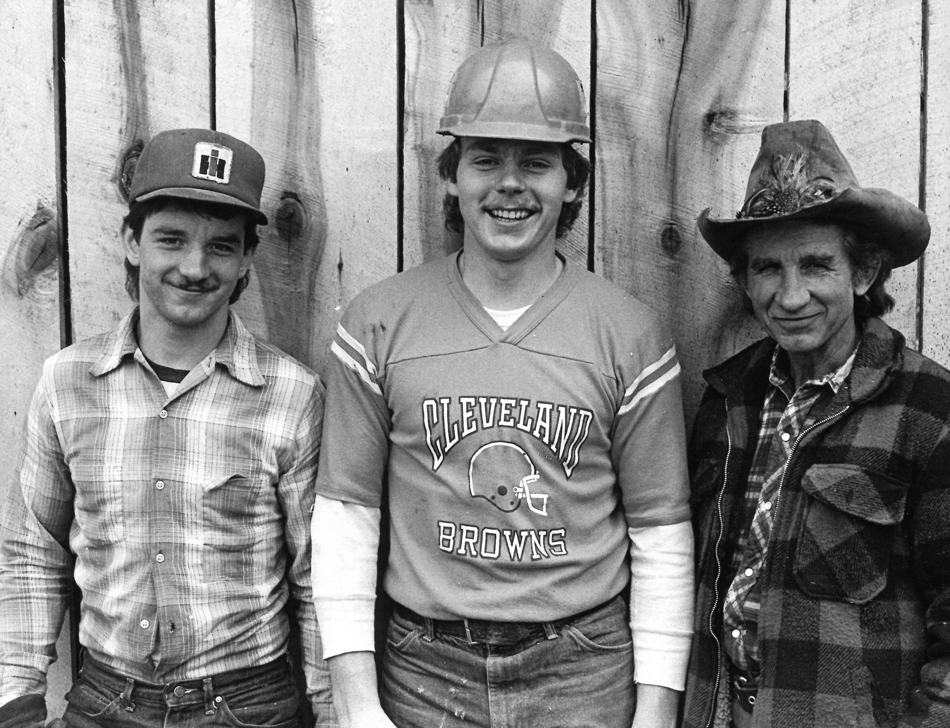

Slide 8
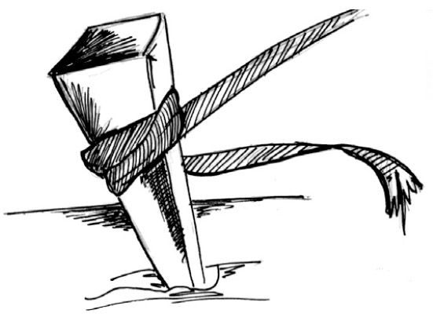

Slide 9
What you do?
or
How you do it?

Slide 10
Foundation
Luke 6:38 - “Give, and it will be given to you: good measure, pressed down, shaken together, and running over will men put into your lap. For with the same measure that you use, it will be measured back to you.”

Slide 11
Foundation
Deut 8:18 - “Remember the Lord your God, for it is He who gives you power to get wealth, that He may establish His covenant.”

Slide 12
Foundation
Mal 3:10 - “Bring all the tithes into the storehouse, that there may be meat in my house, and prove me now, says the Lord , if I will not open you the windows of heaven, and pour you out a blessing, that there shall not be room enough to receive it.”

Slide 13
What’s In Front Of You?
John 14:26 - But the Helper, the Holy Spirit, whom the Father will send in My name, He will teach you all things.
Deuteronomy 15:10 - The LORD your God will bless you in all your work and in everything you put your hand to.

Slide 14
Thriving or Toxic Workplaces
#1 Attribute of a Thriving Workplace is Sense of Personal Concern

Slide 15
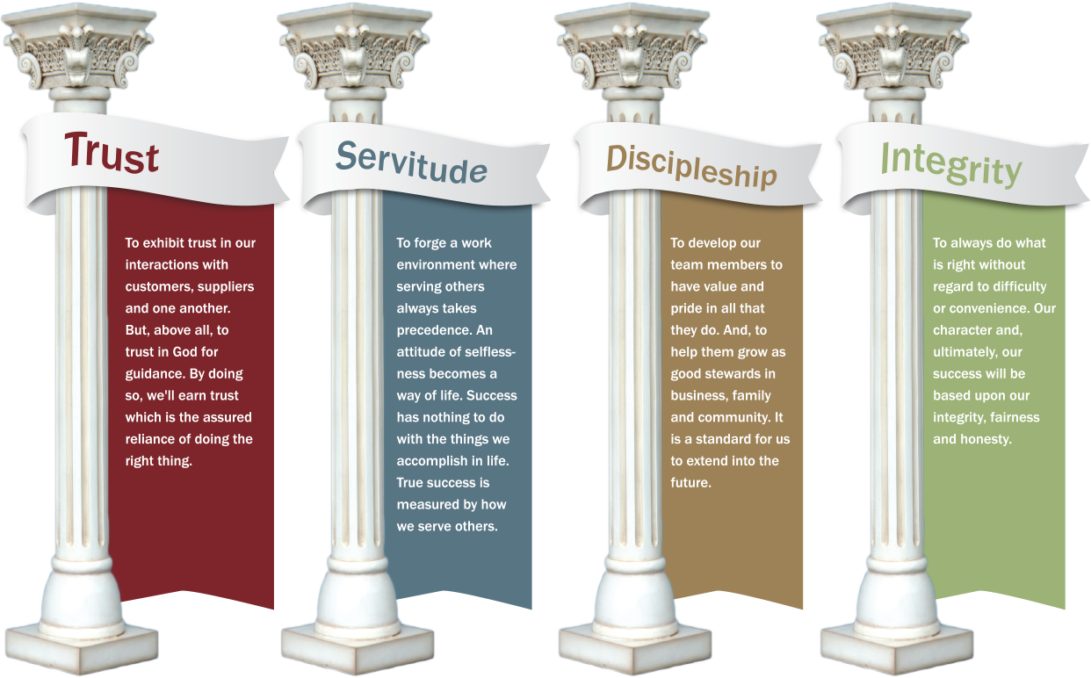
Our Pillars
Proverbs 3:6

Slide 16
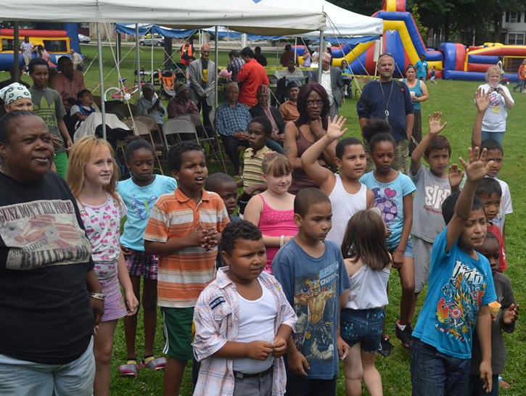
Pictured: Family Fun Day event in Rochester, NY

Slide 17
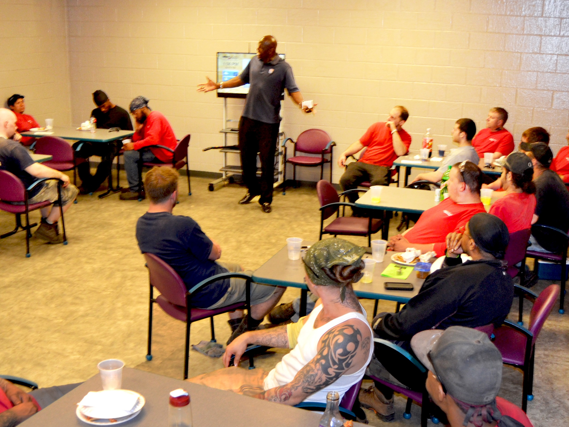
Pictured: Devon McDonald speaking to Vienna, OH facility

Slide 18
Pictured: Mondell Elliott, plant manager, with children of Guatemala

Slide 19
Our Pillars
Proverbs 3:6

