Slide 1

ELO – WORLD CONFERENCE 2015
What a Christian Entrepreneur Needs to Know to Understand the Economy
November 4, 2015
Pan Pacific Hotel, Vancouver
Peter Hall
Vice-President and Chief Economist
`

Slide 2
THE COMMODITY PRICE SLUMP

Slide 3
VOLATILITY, BY THE INDEXES
Indexes of market volatility
Sources: Census Bureau, Haver Analytics

Slide 4
US EMPLOYMENT: GOING CRITICAL?
Monthly employment change, ‘000, unemployment rate (%)
Sources: US Census Bureau, NAR, Haver Analytics

Slide 5
EU: RETURNING TO BALANCE?
EA building permits, all buildings, ‘000 m²
Sources: Eurostat, Haver Analytics

Slide 6
CHINA’S TRADE COMEBACK
Trade as a share of GDP, per cent
Sources: EIU Country Data, Haver Analytics

Slide 7
CHINA’S TRADE COMEBACK
Trade as a share of GDP, per cent
Sources: EIU Country Data, Haver Analytics

Slide 8
CHINA: WHAT’S UP WITH THE RMB?
Trade-weighted broad effective exchange rate, 2010 = 100
Sources: JP Morgan, Haver Analytics

Slide 9
EXCESS LIQUIDITY: DISTORTIONS?
Stock Market
Currencies
Cash injection
Sovereign Debt
Cash hoarding
Corporate Bonds
‘Dodgy’ loans
Cash already in the system
Corporate Bonds
Commodities
Source: EDC Economics

Slide 10
ADD A LITTLE GROWTH, AND…
Stock Market
Currencies
Sovereign Debt
Financial transmission mechanism
Corporate Bonds
‘Dodgy’ loans
Corporate Bonds
Commodities
Source: EDC Economics

Slide 11
DRIVERS OF THE CANADIAN DOLLAR
Oil & gas prices
Non-energy commodity prices
Canadian dollar
Interest rate spreads
US dollar movements*
The ‘halo’ effect
Source: EDC Economics

Slide 12
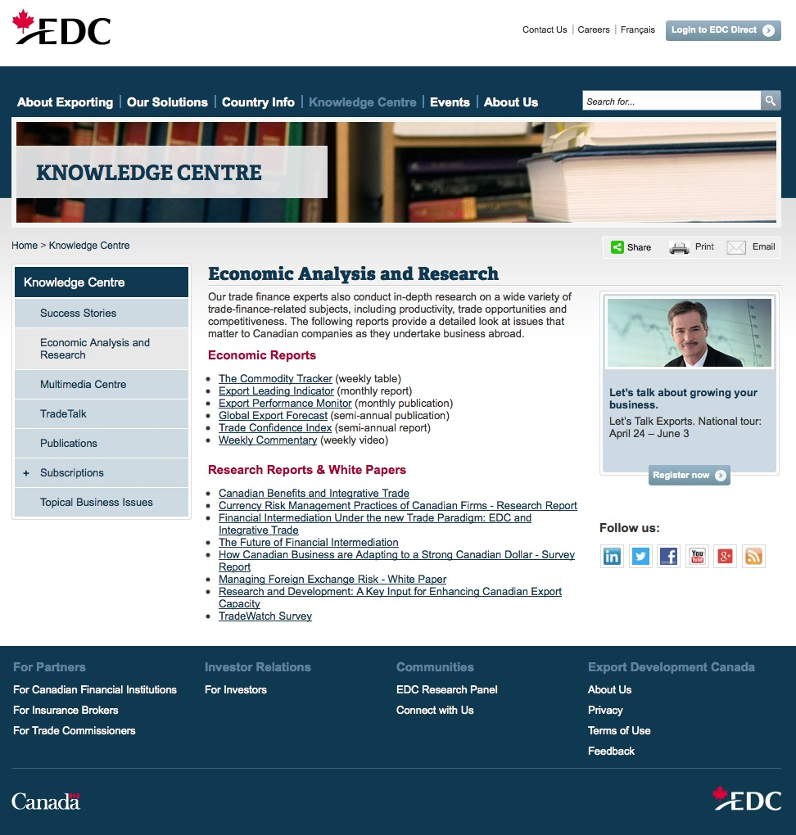
VISIT US ONLINE
www.edc.ca
  Country analysis and information
  Global Export Forecast
  Weekly Commentary
  Trade Confidence Index
  Research reports on international trade

Slide 13

RISKS
Financial sector
Fiscal weakness
Protracted oil price plunge
US falters
Geopolitical disturbances
Hidden protectionism
Aging populations
Capacity to grow

Slide 14
PROVINCIAL TRADE DIVERSIFICATION, 2000-2013
Change in share of merchandise exports to emerging markets, per cent
(⇐ 2000, 2013 ⇒)
Source: Statistics Canada
Notes:
The lower number in the bar is the share of exports going to emerging markets in 2000
The higher number is the share in 2013
This illustrates the state of diversification in each province, i.e. starting levels, ending levels and it illustrates how much diversification has happened over this period
SK: highly diversified, but little change
AB, NB, low diversification and little change
BC: higher diversification and lots of change
PEI, lower diversification but lots of change
The rest: a decent amount of diversification, from various starting points

Slide 15
IMPACT OF OIL PRICES ON THE GLOBAL ECONOMY

Slide 16
IMPACT OF OIL PRICES ON THE CANADIAN ECONOMY
Oil Price Impact by Economic Sector, % of GDP
Category | Oil Price, WTI Crude, $US
Oil price scenario: | $75 | $60 | $40 | $25
O&G direct | -1.6% | -2.6% | -3.8% | -4.8%
Indirect investment | -0.2% | -0.3% | -0.4% | -0.5%
Manufacturing (cost) | 0.6% | 1.0% | 1.5% | 1.8%
Manufacturing (effect of $) | 0.7% | 1.2% | 1.8% | 2.2%
Consumer | 0.4% | 0.6% | 0.9% | 1.2%
Fiscal | -0.1% | -0.2% | -0.3% | -0.4%
Net impact, % of GDP | -0.16% | -0.26% | -0.39% | -0.48%

Slide 17
INDUSTRIAL TRADE DIVERSIFICATION, 2000-2014
Change in share of merchandise exports to emerging markets, per cent
(⇐ 2000, 2014 ⇒)
Source: Statistics Canada
Notes:
The lower number in the bar is the share of exports going to emerging markets in 2000
The higher number is the share in 2013
This illustrates the state of diversification in each province, i.e. starting levels, ending levels and it illustrates how much diversification has happened over this period
SK: highly diversified, but little change
AB, NB, low diversification and little change
BC: higher diversification and lots of change
PEI, lower diversification but lots of change
The rest: a decent amount of diversification, from various starting points

Slide 18
THE GREAT UNWIND: WHO IS VULNERABLE?
Country Vulnerability Index
Real credit growth
C/A Balance, % of GDP
Portfolio Investment Liabilities
1-yr Probability of Default
Source: EDC Economics

Slide 19
PROVINCIAL EXPORT OVERVIEW
 | CAD bn | % Share of Total Exports | Export Outlook (% growth)
 | 2014 | 2014 | 2014 | 2015 (f) | 2016 (f)
Newfoundland and Labrador* | 13.0 | 2.6 | 9 | -14 | 19
Prince Edward Island | 1.1 | 0.2 | 20 | 9 | 4
Nova Scotia | 5.3 | 1.1 | 25 | 7 | 3
New Brunswick | 13.0 | 2.6 | -10 | -10 | 11
Quebec | 74.4 | 15.1 | 15 | 7 | 6
Ontario | 177.3 | 36.1 | 8 | 10 | 2
Manitoba | 13.4 | 2.7 | 6 | 2 | 3
Saskatchewan | 35.1 | 7.1 | 9 | -5 | 7
Alberta | 121.4 | 24.7 | 18 | -17 | 19
British Columbia | 35.5 | 7.2 | 6 | 5 | 6
Total | 491.6 | 100.0 | 11 | 0 | 8
Source: Statistics Canada, EDC Economics, 2014 is actual data while 2015 and 2016 are forecast
*Includes EDC estimate for crude oil exports (*not included in national total from Statistics Canada)

Slide 20
CANADA-EU CETA: TOP 10 IMPACTS
(Canadian exports, by industry, % and CAD)
CHANGE IN BILATERAL EXPORTS, 2014 BASELINE
 | Cdn exports to EU
 | % gain | $C gain
Processed foods | 141.7 | 1,365
Textiles | 73.6 | 115
Petroleum, coal products | 60.2 | 605
Wearing apparel | 60.0 | 95
Construction | 45.7 | 30
Primary agriculture | 41.8 | 791
Chemical products | 34.5 | 555
Leather products | 33.3 | 5
Metals | 29.3 | 861
Motor vehicles & parts | 28.8 | 255
Metal products | 26.7 | 61

Slide 21
CANADA-EU CETA: RISKS, OPPORTUNITIES
(by industry, % and CAD gains)
CHANGE IN BILATERAL EXPORTS, 2014 BASELINE
 | Cdn exports to EU |  | EU exports to Cda
 | % gain | $C gain | % gain | $C gain
Processed foods | 141.7 | 1,365 | 326.2 | 5,571
Wood products | 16.7 | 72 | 30.7 | 235
Petroleum, coal products | 60.2 | 605 | 73.8 | 359
Metals | 29.3 | 861 | 19.4 | 56
Motor vehicles & parts | 28.8 | 255 | 18.3 | 631
Transport equipment | 23.1 | 592 | 7.9 | 183
Primary agriculture | 41.8 | 791 | 6.3 | 23

